Slide 1
Diversity and Inclusion in Open Source Software Development
Tina Li, Iris Gao, Fauziya Mudasir, Rinku Gopali
Featuring Laura Dabbish, Sophie Huilian Qiu, Bogdan Vasilescu
Notes:
Sections we can include:
Motivation
Highlights of your results
Method
Results
Conclusion / summary slide

Slide 2

Motivation & Overview
Problem: Women are underrepresented in tech and especially in open source development.
Research question: How do women engage in open source development?
Method: Analyze participation data from a set of open source projects(Github) to examine differences in contribution for male versus female developers.
Notes:
Open source: Simple, open source software is software with source code that anyone can inspect, modify, and enhance. Examples: Linux, Apache
5% of contributors to public repos on GitHub (OSS survey, Bitergia analysis)

Slide 3
Dataset and feature computation
Data: 200 projects, one file per project, 41133 commits
Explanatory variables:
How large is the audience
Number of stars
How welcoming the project is
Presence of code of conduct
Presence of contributing guideline
Readability and number of headers of README file
Sentiment polarity of README file
Control variables:
Total number of contributors

Slide 4
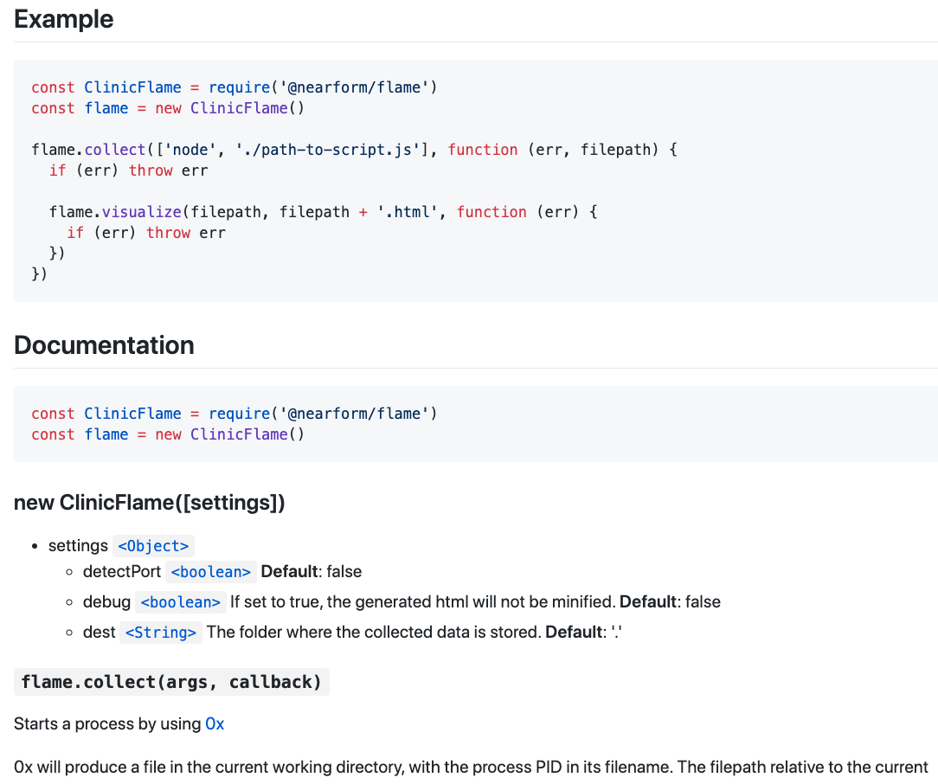
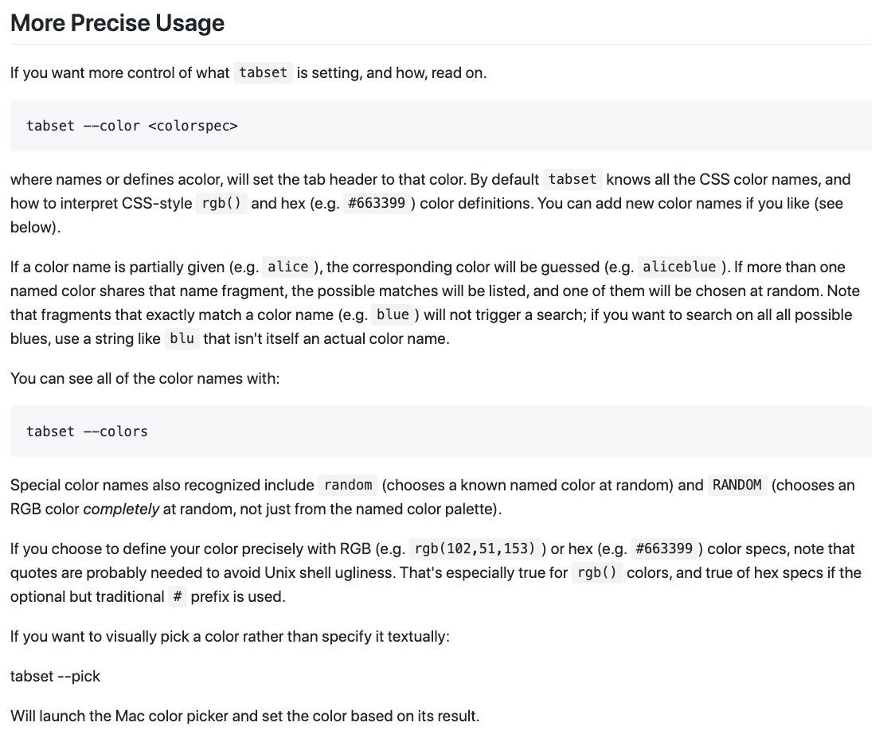
Examples for Readability and Sentiment Scores
Readability score: -59.82
Sentiment score: -0.4986
Readability score: 49.18
Sentiment score: 0.9841

Slide 5
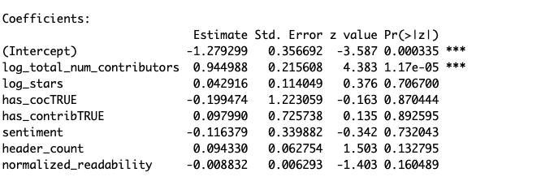
Results
Logistic regression (analyze the correlation between factors)
Projects with higher number of contributors are more likely to have female contributors
😁
😭
😭
😭
😭
😭
😭

Slide 6
Limitations And Future Work
DATASET LIMITATIONS
small sample size
all data from npm
ANALYSIS OF DATA
improve libraries/APIs for performing sentiment/readability analysis
additional features to consider when collecting data. Eg:politeness in comments
Notes:
Doc: https://docs.google.com/document/d/19JUZQb01rbcu-AcquVLCZ2wCC8ctmeIEWxIbr72o3OQ/edit

Slide 7
What is your perception / experience with OSS?

